Slide 1
Objective
Students will be able to explain the most important issues of Andrew Jackson’s domestic policy by completing guided reading questions

Slide 2
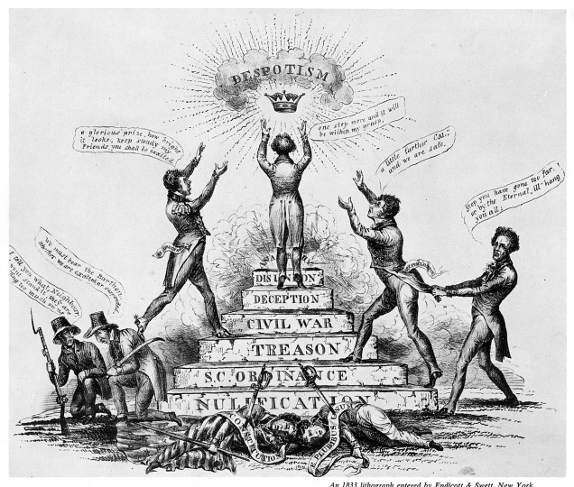

Slide 3
Nullification Crisis Picture
What is the man on top of the podium reaching for? What does that symbolize?
Where is Andrew Jackson in the picture? What is he doing?
What did the man at the top of the podium have to “destroy” to get there?
Which side supports the man on the podium? Which side does not? How do you know?

Slide 4
Nullification Reading (364-365)
Who are the main two people arguing about nullification (note the picture on pg. 365)
Why did South Carolina want to nullify,or get rid of, a federal law raising taxes on iron and other goods?
What were the main arguments for and against nullification of the Federal law?
How does the crisis end?

Slide 5
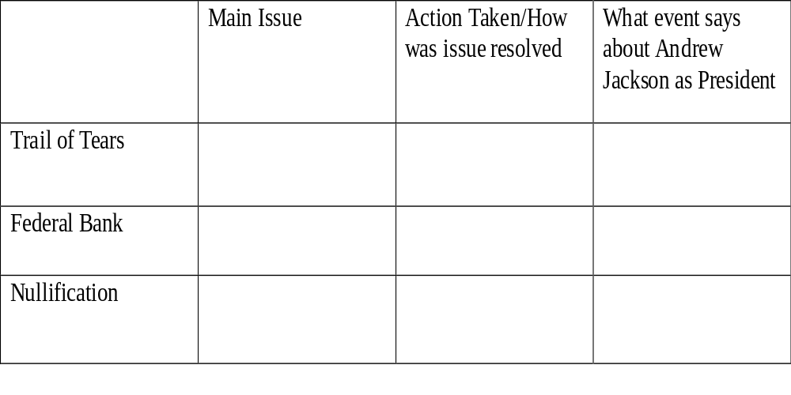
Andrew Jackson Chart

